Slide 1
Privacy Preserving Machine Learning Training
Gauri Gupta - 2017MT60207
Under the supervision of Prof. Rijurekha Sen
Co-supervisor: Prof. RK Sharma
Notes:
Good afternoon, everyone. I am Gauri Gupta and I am pursuing my M.tech thesis under the supervision of Prof. Rijurekha Sen and my co-supervisor from the department is Prof. RK Sharma.
I am working on Privacy preserving ML which is an important research topic these days. We are exploring ML model training for different tasks like. interpolating and forecasting pollution data using secure MPC.

Slide 2




PM interpolation using MPC, across fleet companies
known
needs interpolation unknown
Private pollution values of party Blue
Shares from all the servers
Blue’s share of merged grid
Notes:
MPC or Secure Multi-Party Computation helps in computing functions across parties who don’t trust each other. Each party holds part of the inputs needed to compute the function. They don’t share these inputs but still the function output can be computed without revealing any input to the other parties, through MPC.
When vehicle mounted sensors are used for scaling urban measurements like air pollution, road surface quality or travel time, then private fleet companies like Ola, Uber, Swiggy, Zomato, Amazon, FlipKart and public fleet companies like DTC and DIMTS buses, should pool their data for better urban coverage. But spatio-temporal trajectory of fleets is sensitive information for fleet companies, especially private companies, more so if they are competing companies (Uber vs. Ola, Swiggy vs. Zomato etc.).

Slide 3
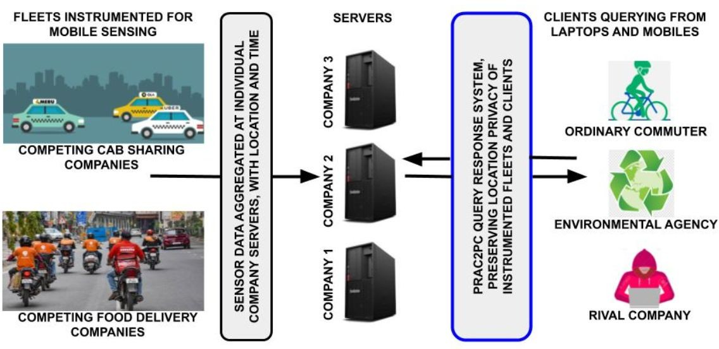
Problem Description
Notes:
The problem involves responding to client queries based on pollution data collected by various cab and delivery companies for a particular city. The client is interested in knowing the level of pollution on their route along with how reliable the information is. At the same time, the client doesn't want to share their exact location. Similarly, the rival companies e.g. Uber, Ola, want their sensitive data to be secure as it is possible to estimate their fleet location using confidence scores. We aim to provide secure MPC training in the above discussed scenario using secure multiparty computations on graph ML models like GCN and spatio-temporal models.

Slide 4
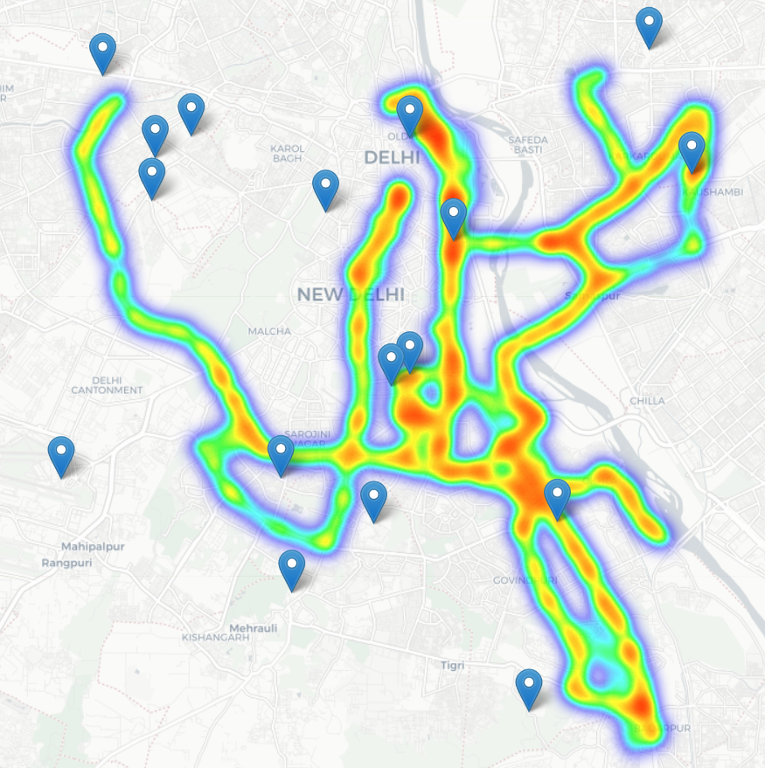


Estimating pollution values at unknown locations
How to measure Pollution Effectively in almost real time?
- Interpolate pollution values based on values of neighbours.
Local Buses Equipped sensors
Partial Data
Complete Data
Interpolation
Notes:
Air pollution is one of the major concerns for big cities. Predicting air quality for any regions and at any time is a critical requirement of urban citizens.
Figure shows an example of the spatial coverage by public buses on 3 routes in New Delhi, where we instrument the buses with air pollution monitoring sensors. The government deployed static pollution sensors, marked as landmark icons in the figure, show significantly lower spatial coverage than bus-mounted sensors. While the sesnors and buses cannot be present in all regions of a city, we can use this data collected for other locations to interpolate and forecast the pollution values throughout the city. Interpolation computes missing values at uniformly sampled grid points in the city.
For the unknown points, we perform interpolation. Interpolation computes missing values at uniformly sampled grid points in the city. The servers have their respective pollution values at different grid points. The interpolation is done securely by secret sharing of these values. Consequently, we need to interpolate and predict air pollution in areas that do not have observation stations nearby.

Slide 5
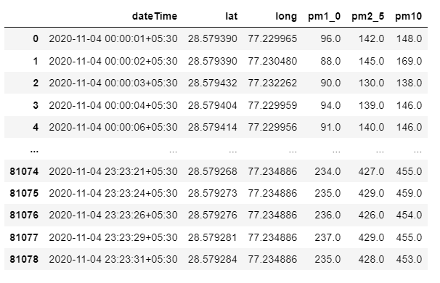
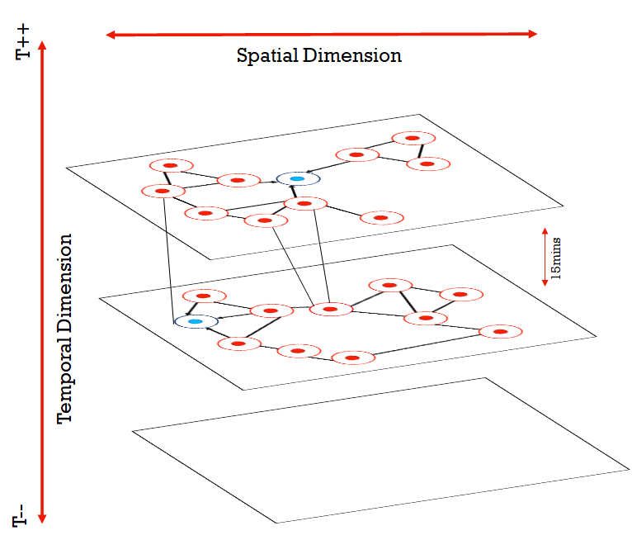
Spatio-temporal dataset
Notes:
Air pollution prediction is a quintessential example of spatio-temporal problems for which we want to model deep learning framework using spatio-temporal
data. However, air pollution prediction for the whole city is a challenging problem due to two main inter-linked factors. (1) the complex spatial dependency on bus networks, and (2) non-linear temporal dynamics with changing temparture and humidity values. The dataset consists of different PM values like PM2.5, PM10, and PM1.0 collected from 13 bus sensors on 3 different bus routes at different time stamps during the day.

Slide 6
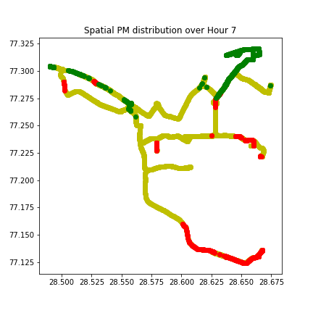
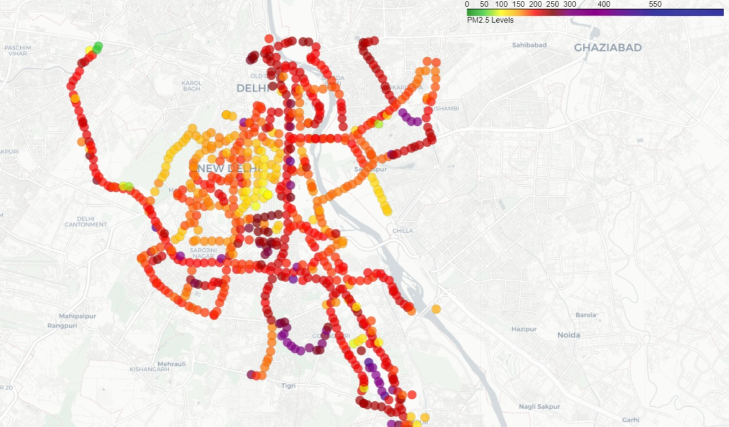
Spatial Dependencies
2020-12-24
Safe zone – less pollution
Intermediate zone – med pollution
Danger zone – high pollution
Notes:
Spatial dependence.
The change in pollution values is controlled by the topological structure of the Delhi sensor locations. The figure on the left shows the average PM2.5 values on a single day in the month of December for the points in our trajectories. Lighter colored points indicate lesser pollution levels while darker colored points indicate more pollution levels.
The figure on right shows average PM2.5 values for the month of January. It shows that January has higher pollution levels with it’s own regions where densely located dark points can be found. Acquiring these complex spatial dependence is a key problem in air pollution prediction.

Slide 7
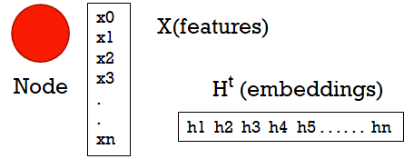
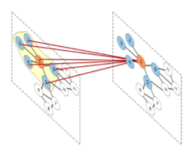
Models for Pollution interpolation
Idea: Graphs
-Deploy a Graph network that can learn relationships(weights) and interpolate to unknown values.
Known value
Known value
H = F (H, X)
O = G (H, X)
w₁
w₂
H ^{t+1} = F (H^{t} , X) by Banach’s Fixed Point Theorem
Unknown value
w₃
F is generally an aggregation function, while G is Linear NN.
w₄
Known value
Known value
Neighborhood data sharing among nodes of a graph in form of intermediate embeddings.
Graph Convolution Networks.
T++
Notes:
How can we capture the spatial dependencies in the data for our task for interpolation? The idea is to use a Graph network that can learn these relationships and interpolate to unknown values.
Graph Neural Networks (GNN) have recently become more popular due to their ability to operate on the Graph structure, giving them applications in areas such as social networks, recommender systems, transportation systems, etc.
We explore the use of Graph Convolutional Network for modelling our data and performing interpolation on pollution values.

Slide 8
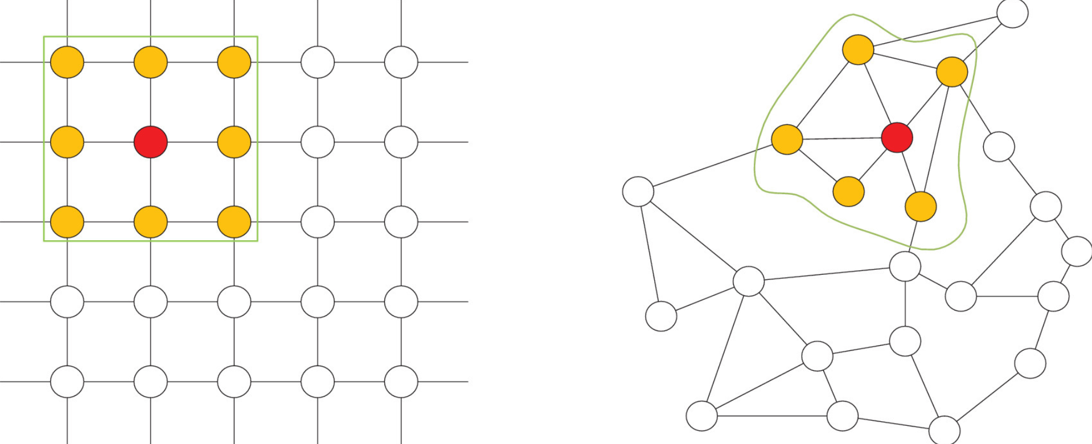
Assumptions and modelling
100 x 100 grid
Edge if
Adjacent node
200m radius,
15min radius
A data point, as recorded by Bus Sensor at lat, long, time.
Notes:
Let us now look at the experiment setting and pre-processing for interpolation. So, the city is divided into grids. The servers have their respective pollution values at different grid points. They secretly share these values and averaging is done on all known points. However, the data is relatively sparse with only values for 2% grid points known in an hour. We use a graph network to model the sensor locations in which the nodes on the graph represent grid points, the edges represent the connection relationships between these grid location. The adjacency matrix is used to represent the connection between adjacent grid points which contains only elements of 0 and 1.

Slide 9
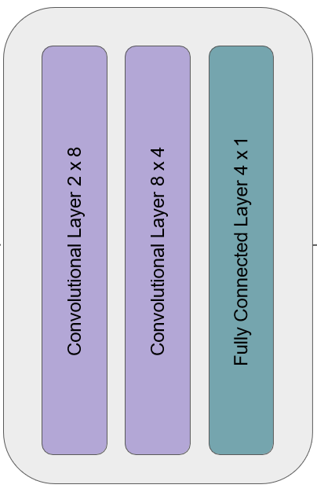
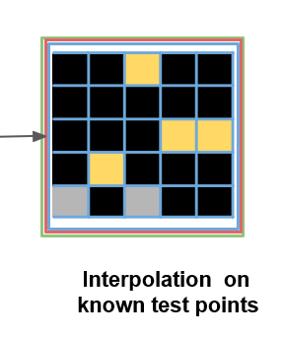
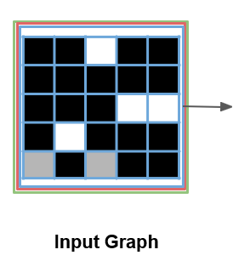
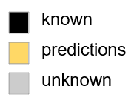
GCN Architecture for interpolation
Notes:
The GCN architecture involves two graph convolution layers followed by a fully connected layer. The input to a GCN is a graph and features of nodes of the graph. The input graph has edges between adjacent grid points. The Adjacency matrix is such that there are outgoing edges only from nodes whose values are known. The output is the values of nodes which have to be predicted.
The GCN is used to capture the spatial topological structure of the graph for obtaining the spatial dependence using data from the Neighborhood nodes in form of intermediate embeddings.

Slide 10
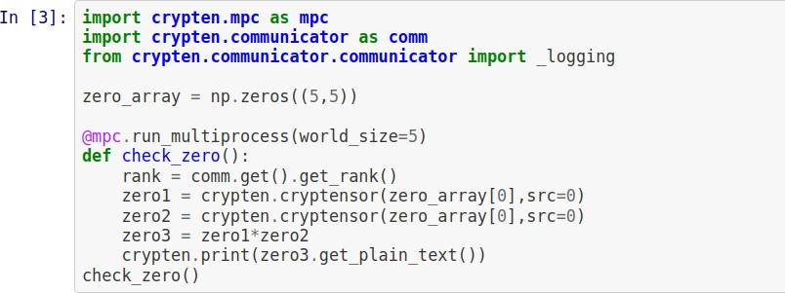



Zero tensor multiplication bug
Challenges: Porting to newer version of Crypten
Loss and gradients were abruptly going to very large values after 40 epochs.
Bug on multiplying zero tensors for parties greater than 2
Exploding loss and gradient occurred in multi party setting
Lowering learning rate lead to delay in explosion.
CrypTen library is under development phase and still evolving
Code written for older CrypTen made compatible to newer version of CrypTen
Notes:
Crypten is Facebook’s state of the art MPC framework that we are using to port plaintext models to secure MPC setting.
Some of the challenges we faced while deploying our model to Crypten framework are:
Loss and gradients were abruptly going to very large values after certain number of epochs.
The Exploding loss and gradient occurred in multi party setting
After performing extensive observation, we observed that there is a bug on multiplying zero tensors for parties greater than 2.
Since CrypTen library is under development phase and still evolving, the latest version of this library has some bugs which needs to be corrected for its use.

Slide 11
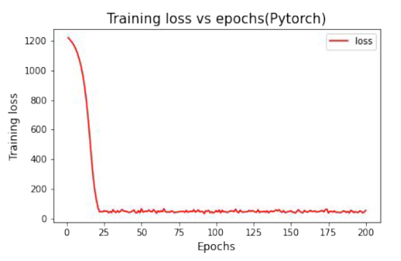
Training for GCN
Epoch: 81 Loss: 70252160.0000
Epoch: 82 Loss: -305522912.0000
Epoch: 83 Loss: 46380312.0000
Epoch: 84 Loss: 160813776.0000
Epoch: 85 Loss: 52756400.0000
Epoch: 86 Loss: -117721264.0000
Epoch: 87 Loss: -88768416.0000
Epoch: 88 Loss: -129376504.0000
Epoch: 89 Loss: 69403984.0000
Epoch: 90 Loss: 154112064.0000
Epoch: 91 Loss: -52687252.0000
Epoch: 92 Loss: -52762532.0000
Epoch: 93 Loss: -79650216.0000
Epoch: 94 Loss: -19431896.0000
Epoch: 95 Loss: -17000588.0000
Epoch: 96 Loss: 45309320.0000
Epoch: 97 Loss: -26707916.0000
Epoch: 98 Loss: 144829616.0000
Epoch: 99 Loss: 161177200.0000
Epoch: 100 Loss: -98503992.0000
Epoch: 101 Loss: -96908088.0000
Epoch: 102 Loss: -28793308.0000
Epoch: 103 Loss: 17095000.0000
Epoch: 104 Loss: 46950820.0000
Epoch: 105 Loss: 54918232.0000
Epoch: 106 Loss: 1236.5186
Epoch: 107 Loss: 92077584.0000
Epoch: 108 Loss: 148256592.0000
Epoch: 109 Loss: 82389408.0000
Epoch: 110 Loss: -92805336.0000
Epoch: 111 Loss: -95151504.0000
Epoch: 112 Loss: 13480734.0000
Epoch: 113 Loss: -25016712.0000
Epoch: 114 Loss: 151563600.0000
Epoch: 115 Loss: 310686784.0000
Epoch: 116 Loss: -4376353.0000
Epoch: 117 Loss: 128781856.0000
Epoch: 118 Loss: -192973664.0000
Epoch: 119 Loss: 45535420.0000
Epoch: 120 Loss: -9157298.0000
Epoch: 121 Loss: 76687720.0000
Epoch: 122 Loss: 122621152.0000
Epoch: 123 Loss: 10058780.0000
Epoch: 124 Loss: 7382360.0000
Epoch: 125 Loss: 42120364.0000
Epoch: 126 Loss: -87239432.0000
Epoch: 127 Loss: -129679248.0000
Epoch: 128 Loss: 126353288.0000
Epoch: 129 Loss: -220868816.0000
Epoch: 130 Loss: 36751176.0000
Epoch: 131 Loss: -61887348.0000
Epoch: 132 Loss: 162319296.0000
Epoch: 133 Loss: 136983264.0000
Epoch: 134 Loss: -15181433.0000
Epoch: 135 Loss: -96868808.0000
Epoch: 136 Loss: -45682848.0000
Epoch: 137 Loss: 136753920.0000
Epoch: 138 Loss: -253750928.0000
Epoch: 139 Loss: 65483944.0000
Epoch: 140 Loss: 20876564.0000
Epoch: 141 Loss: 107623504.0000
Epoch: 142 Loss: 58720616.0000
Epoch: 143 Loss: 67654168.0000
Epoch: 144 Loss: 106966208.0000
Epoch: 145 Loss: -6814842.0000
Epoch: 146 Loss: 151497632.0000
Epoch: 147 Loss: -73384088.0000
Epoch: 148 Loss: 69881312.0000
Epoch: 149 Loss: 80237912.0000
Pytorch training for GCN
Training time = 4.22
Test_RMSE = 50.8
Crypten training in fixed point doesn’t converge for GCN.
Notes:
The GCN model owing to its small and sophisticated structure takes quite less time around 4secs with testRMSE of around 50 when trained on Pytorch. However, While training GCN in Crypten framework we observe that the crypten training doesn’t converge in fixed point whereas it works as desired in Pytorch plaintext version. Currently, while modelling using GCN we were only taking into account the spatial features and ignoring the temporal dependencies among them leading to higher RMSE values.

Slide 12
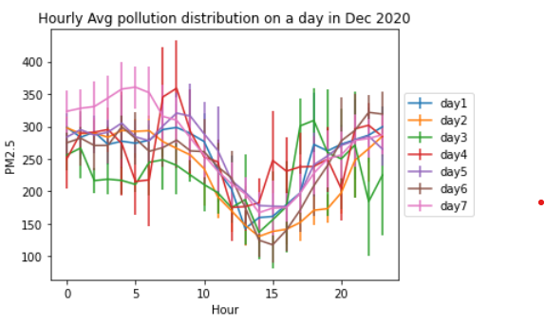
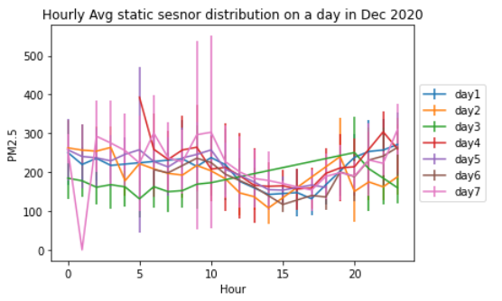
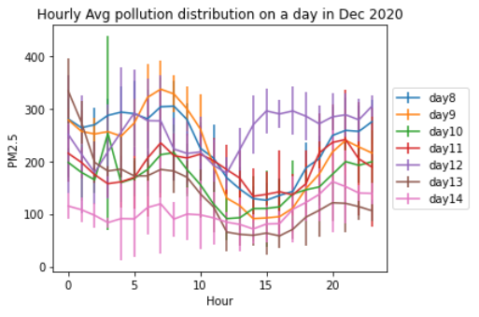
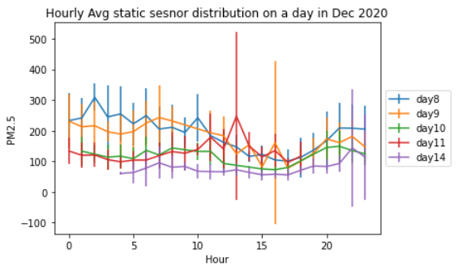
Short-term temporal dependencies within a day
Bus sensors
Static sensors
Notes:
Short-term dependencies over a day
The pollution values also change dynamically over time and is mainly reflected in periodicity and trend. The PM values have tendency change within a single day. The figures shows the PM values variations on different days in month of December collected from both the bus and static sensors. As seen, the pollution values with a single day vary in repeating patterns where a daily dip of pollution is seen at Hour 15 on almost all days. These data trends also align with the reasoning of low pollution at hours of high temperature i.e. 3PM-4PM of the day.

Slide 13
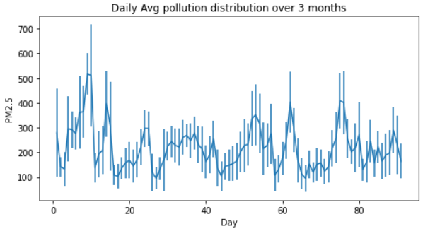
Long-term temporal dependencies
Notes:
Periodicity.
The air pollution values also changes periodically within days spread across months. However, the temporal series may also vary a lot across days and thus modelling these long-term and short-term temporal dependencies in the data is a non-trivial task. For example, the present pollution value at a location is affected by not only the air quality at the neighboring regions but also the air quality of the previous moments or even longer durations than that.
In order to predict the values at a particular location at a given instant, the historical values of the feature for that entity as well as the feature values of the entities “connected” to the entity is also important.
For example, the historical data of the sensors are the timeseries and the distance between the sensors is the indicator for connectivity or closeness of sensors.
As shown in Figure 2(a), the values shows a periodic change and repeating patters within months of data.

Slide 14
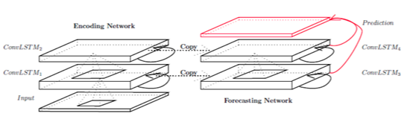
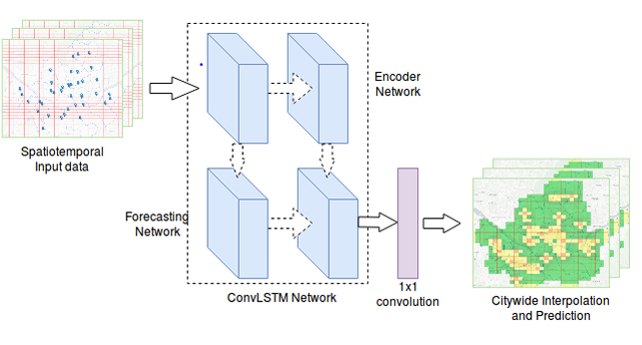
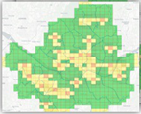
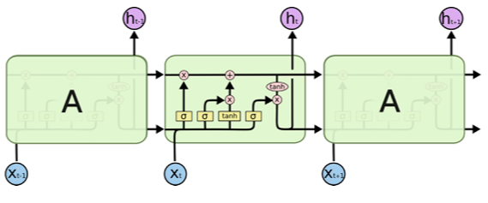
ConvLSTM for interpolation
Encoding-Forecasting ConvLSTM structure for spatiotemporal sequence
The architecture of a common LSTM layer with three consecutive LSTM cells.
The Spatiotemporal Deep Learning model for Interpolating
Notes:
We use (ConvLSTM) model, a combination of Convolutional Neural Networks and Long Short-Term Memory, which automatically manipulates both the spatial and temporal features of the data.
We divide the city into a grid and assign collected air pollution data into grid-cells. The value in a cell is the aggregated value of all assigned stations values at a timestamp t. Additionally, we alo add another dimension of time and aggregate similar grid-images at different time instants during the day. Thus, at any time t, we have a grayscale image of grid representing for the entire city.
The model architecture consists of two networks, encoder and forecaster. Both these networks are stacks of many ConvLSTM layers. An LSTM cell uses some ”gate” mechanisms such as forget gate, input gate and output gate to decide which part of the information will be output from the cell state and which information will be stored. The output of the model is a grid which we can use to determine pollution values in the city.

Slide 15
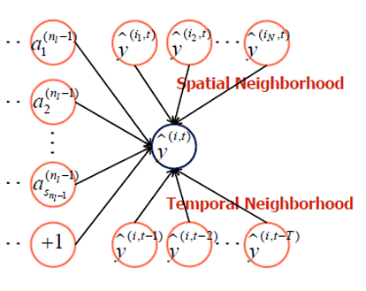
Extending to Spatio-temporal models
MODEL | TrainTime_plain | TestRMSE_plain
GCN | 4.22 | 50.8
ConvLSTM | 1022 | 46.09
Training slow in plaintext itself, will be very slow in MPC with encrypted computations and communications.
Training slow without much improvements in testRMSE values
Notes:
We see that ConLSTM approach is suitable for spatiotemporal pollution prediction problem and also outperforms GCN. However, it takes longer time to train which will not serve as a good model to encrypt as MPC computations will further add the latency overhead.

Slide 16
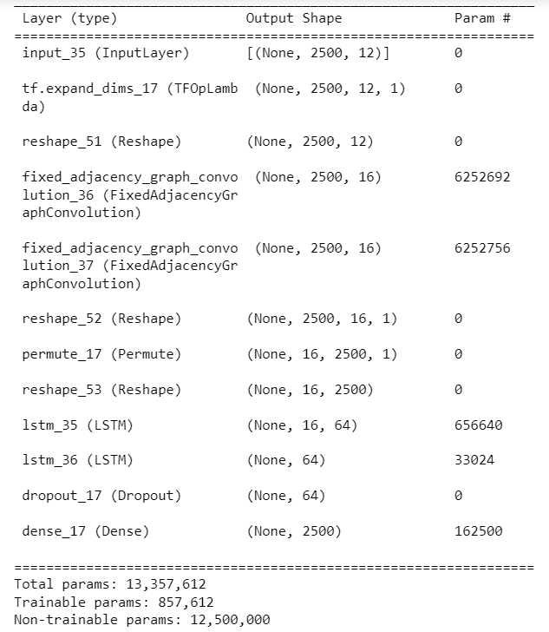
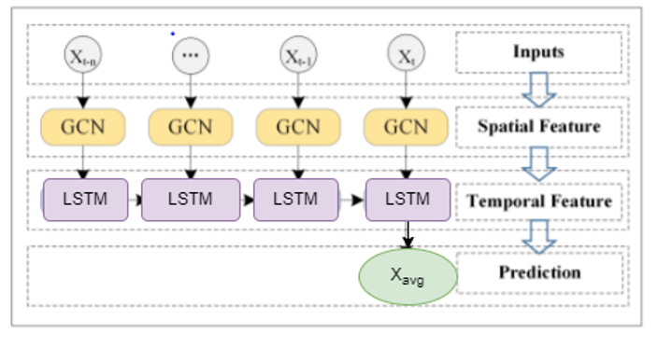
GCN_LSTM for interpolation
Notes:
Next, we explore the use of another spatio-temporal model. The GCN-LSTM model integrates the graph convolutional network and LSTM units. The graph convolutional network is used to capture the topological structure of the sensors for modeling spatial dependence. The LSTM unit is used to capture the dynamic change of pollution data for modeling temporal dependence. The model constists of multiple graph convolution layers stacked over multiple LSTM to predict pollution values. The architecture of GCN_LSTM also allows for user defined number GCN layers and user defineded number of LSTM layers. The dropout and a Dense layer at the end improves the model performance and manages over-fitting.
Unlike in ConvLSTM, here we use complete graph modelling entities of GCN layers which captures the spatial relations well.
As shown in Figure 3, we first use the historical n time series data as input and the graph convolution network is used to capture topological structure of the network for obtaining the spatial features. Second, the obtained time series with spatial features are input into LSTM unit model and the dynamic change is obtained by information transmission between the units, to capture temporal features.
In summary, the GCN-LSTM model can deal with the complex spatial dependence and temporal dynamics.

Slide 17
Extending to Spatio-temporal models
MODEL | TrainTime_plain | TestRMSE_plain
GCN | 4.22 | 50.8
ConvLSTM | 1022 | 46.09
GCN_LSTM | 24.04 (on cpu) | 41.74
Best for deployment
Best RMSE scores among these graph networks
Less training time(currently calculated on CPU) in plaintext itself, and low testRMSE
Notes:
GCN_LSTM performs better than both GCN and ConvLSTM models with testRMSE values of around 41. It also takes lesser training time which is around 24 s on CPU. When calculated on GPU, the training time will be further reduced leading to better inferences. The GCN-LSTM model successfully captures the spatial and temporal features from the pollution data and thus provides is a promising model capturing the training-vs-latency tradeoff that could be ported to crypt MPC setting.

Slide 18
Inference and Results
of different models
Notes:
Finally, let us now look at the inference and results of using different models for our task.

Slide 19
Many interpolation models, but porting to MPC?
Crypten is Facebook’s state of the art MPC framework. We are trying ML model training using Crypten, to check model training time and RMSE of the trained model on unseen test data.
MODEL | TrainTime_plain | TestRMSE_plain
GPR | 3433.04 | 29.74
Variational GPR | 1053.88 | 30.63
GraphSage | 4891.81 | 34.15
ANN | 141.42 | 32.49
GCN | 4.22 | 50.8
ConvLSTM | 1022 | 46.09
GCN_LSTM | 24.04 (on cpu) | 41.74
Some models have functions like Cholesky decomposition, that are difficult to approximate with additions and multiplications, the building blocks of MPC. This makes porting difficult.
Training slow in plaintext itself, will be very slow in MPC with encrypted computations and communications.
Notes:
Till now, we have explored several models for the interpolation task. For models like Gaussian Processes, Variational GPR and GraphSage, training slow in plaintext itself, will be very slow in MPC with encrypted computations and communications. These models have functions like Cholesky decomposition, LazyTensors that are difficult to approximate with additions and multiplications, the building blocks of MPC. Thus, makes porting difficult.

Slide 20
Many interpolation models, but porting to MPC?
Crypten is Facebook’s state of the art MPC framework. We are trying ML model training using Crypten, to check model training time and RMSE of the trained model on unseen test data.
MODEL | TrainTime_plain | TestRMSE_plain
GPR | 3433.04 | 29.74
Variational GPR | 1053.88 | 30.63
GraphSage | 4891.81 | 34.15
ANN | 141.42 | 32.49
GCN | 4.22 | 50.8
ConvLSTM | 1022 | 46.09
GCN_LSTM | 24.04 (on cpu) | 41.74
Crypten training in fixed point doesn’t converge for GCN.
Notes:
The GCN model owing to its small and sophisticated structure takes quite less time around 4secs as compared to the huge GP models. However, Crypten training in fixed point doesn’t converge for GCN.

Slide 21
Spatio– temporal interpolation models
MODEL | TrainTime_plain | TestRMSE_plain
GPR | 3433.04 | 29.74
Variational GPR | 1053.88 | 30.63
GraphSage | 4891.81 | 34.15
ANN | 141.42 | 32.49
GCN | 4.22 | 50.8
ConvLSTM | 1022 | 46.09
GCN_LSTM | 24.04 (on cpu) | 41.74
Best for spatio-temporal modelling and low training time
Notes:
The air pollution data has both complex spatial as well as temporal dependencies. Therefore, to efficiently predict air pollution anywhere (interpolation) and at any time (forecasting), GCN_LSTM leverages both spatial and temporal features with lower training time and better RMSE values. In collobaration with Microsoft research India, we are trying to port these models to a new floating point MPC training framework.

Slide 22
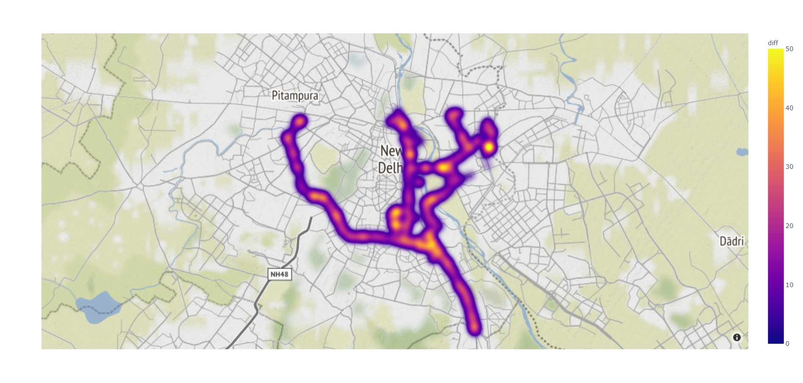

Achievements
Problems
Accuracies Brilliant – Problem in Data.
Buses travelling on constant route.
Required data from randomly moving taxis, vehicles, bikes.
Low RMSE Achieved @pm2.5 level
Training time <20s (good for encryption)
=> GCNs are inherently suited for interpolation. LSTMs are best for forecasting. GCN-LSTM is best suited for spatio temporal data
Have never been used for interpolation
Inference lacks reliability
but
Looks Good!
Notes:
We have achieved low RMSE values for @pm2.5 level with training time <20s which is good for encryption.
The Graph Convolution Networks are inherently suited for interpolation while the LSTMs are best for forecasting and predictions. The hybrid model of GCN-LSTM is best suited for modelling spatio temporal data which have have never been used for interpolation tasks.
However, the challenges in modelling are: 1. The data is very sparse. Only 2% grid points are known in an hour which makes the task challenging.
2. The buses travel on constant routes so, we have information missing from certain locations.
3. In order to improve the model performance we need to capture more data from from randomly moving taxis, vehicles, bikes.
4. The model inference lacks reliability or confidence scores.

Slide 23
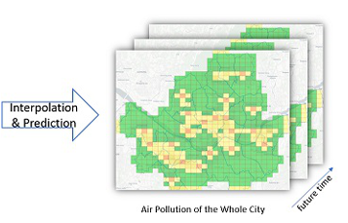
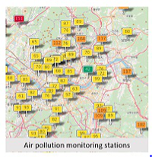
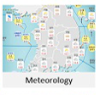

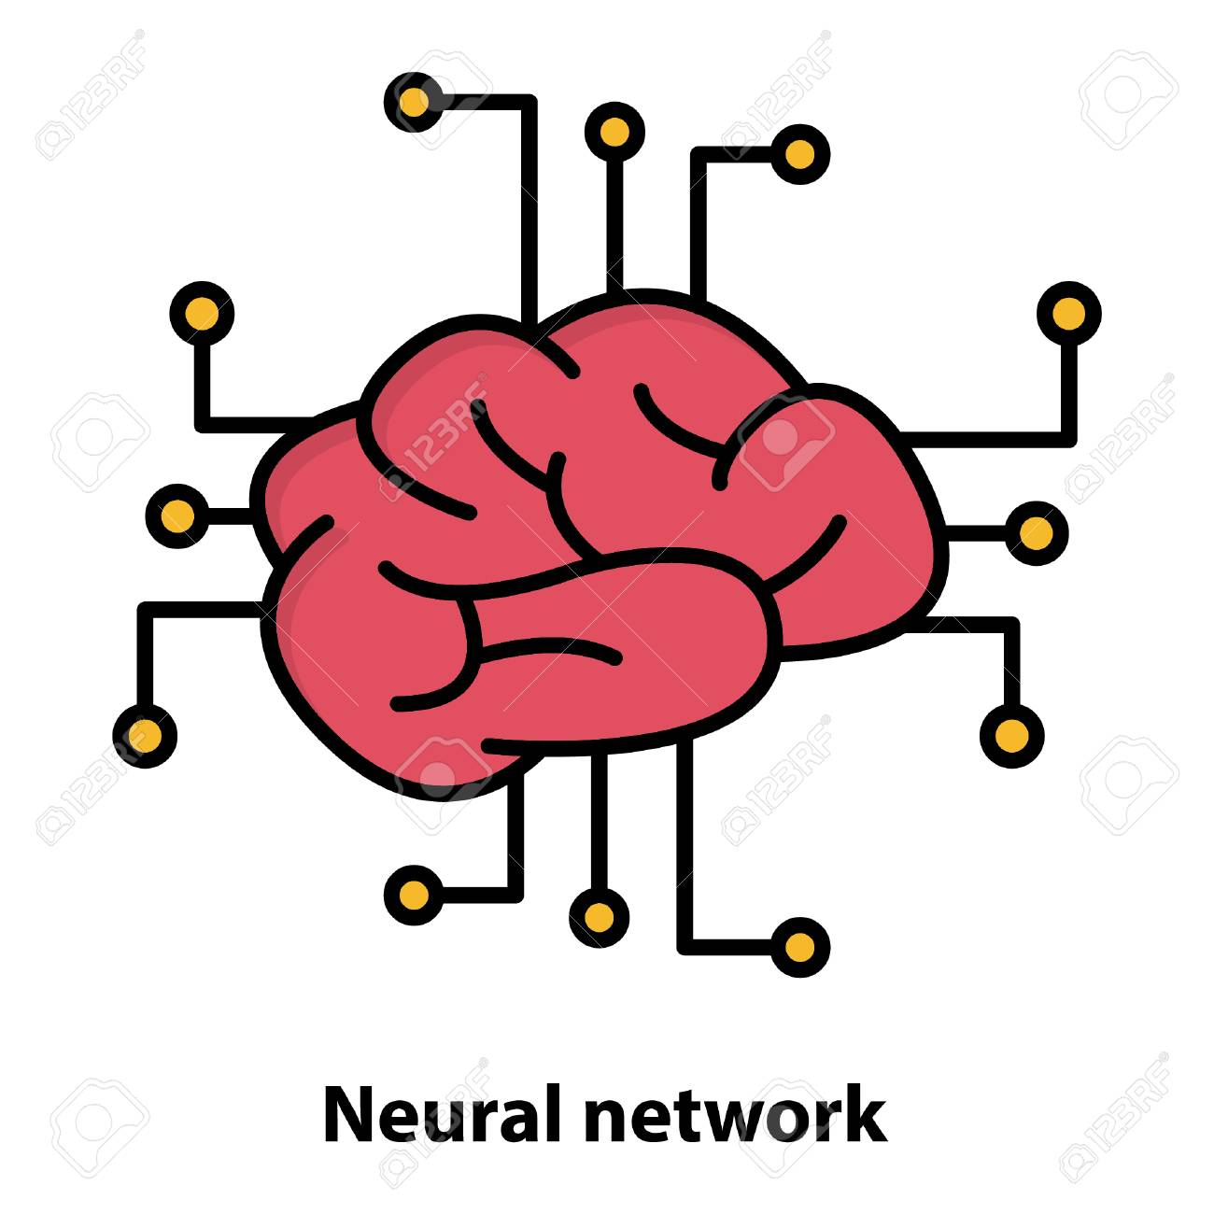
Roads Ahead
Enhanced
models
Model Enhancements – GAT( Graph Attention Networks)
Use data from other factors like – metorologial data
Perform Interpolation as well as forecasting of pollution values
Transferibility of model with limited training requirements.
Modifying/Increasing Data to more randomized vehicles!!
Data
Notes:
Some of the future works that holds for us is:
1. First, we can further improve the model performance by using attention layers in GCN structure which have proven to give better results in spatial modelling.
2. Second is that many factors influence air quality and PM values. For example, temperature, humidity, precipitaion, the wind speed, wind direction make air pollution varies from locations to locations. We want to further incorporate the metorological data for prediction of more accurate pollution values
3. We also want to extend the current models for interpolation to forecasting into future time.
Thank you!

Slide 24
Thank You!

